Slide 1

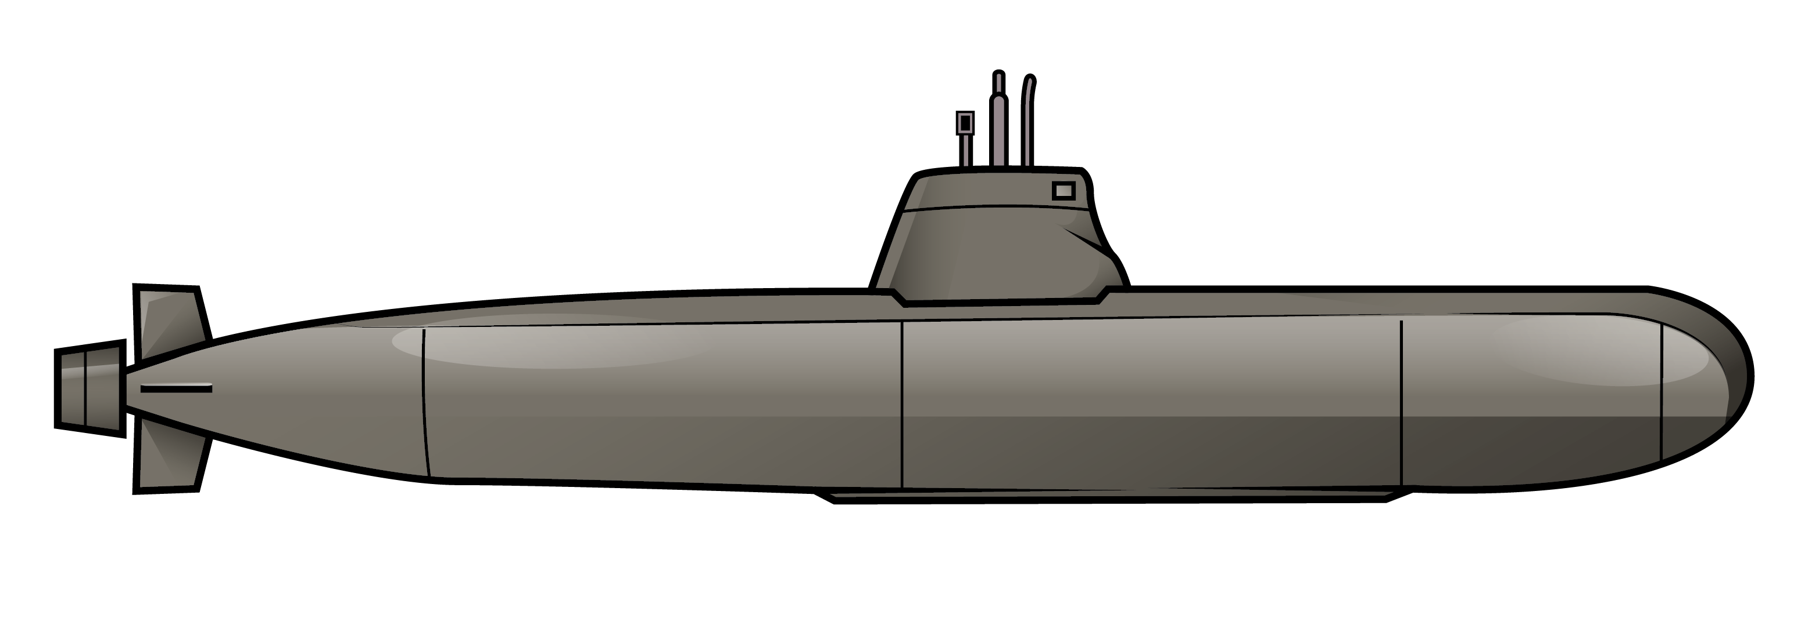
FPGA for Software Developers
(on U-Boat)
Miodrag Milanovic

Slide 2
Scenario
We are reverse engineers from present time
Sent back in time to U-1206 during WWII
Find Enigma and create own copy of it
Only thing that they gave us is FPGA and laptop
But we do not know how Enigma works
We do not even understand how FPGA works
And we have 1 hour limit for doing it
For fun sake we are going to make a diversion at the end

Slide 3
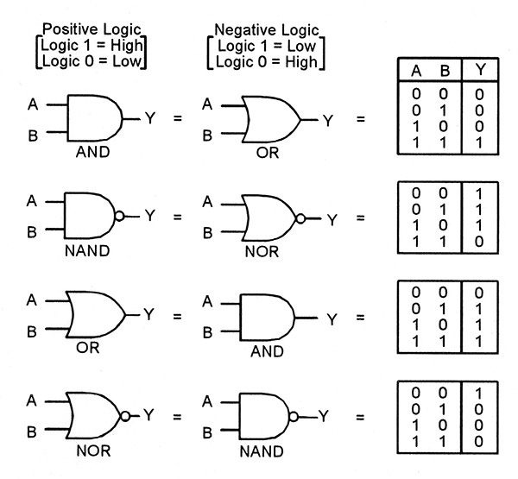
Boolean logic

Slide 4
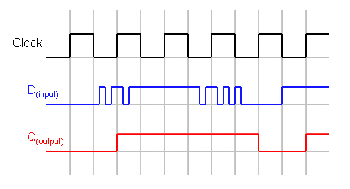
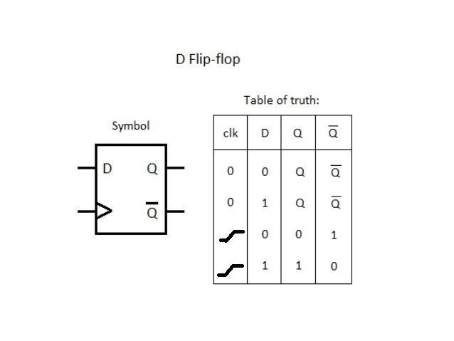
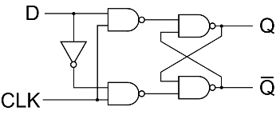
D Flip-Flop

Slide 5
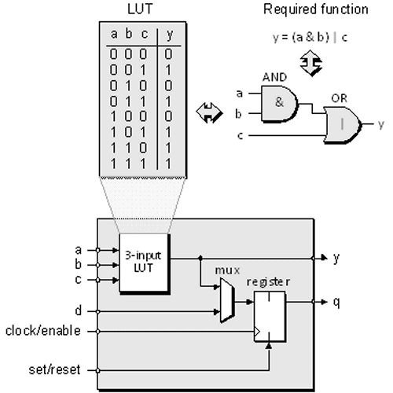
What is FPGA ?
Field Programmable Gate Array
LUT – Look-Up Tables
Clock Tree
I/O Blocks
Dedicated RAM
Vendors : Xilinx, Altera/Intel,
Lattice, Microsemi …

Slide 6
Where FPGA is used ?
Prototyping
Small series commercial products
Where ever power consumption is critical and no budget for ASIC
Implementing security algorithms
Fast network packet analysis
Many, many more

Slide 7
Process of development
Analysis : parsing and validation of HDL (Verilog, VHDL … )
Synthesis : HDL or schematics -> netlist
Place-and-route : netlist -> specific FPGA technology
Assembler : specific FPGA technology -> bitstream
Timing Analysis
Simulation

Slide 8
Open Source Tools
Yosys - Verilog synthesis tool by Clifford Wolf
Arachne PnR - Place and route tool by Cotton Seed
Project IceStorm – Assembler tool by Clifford Wolf and Mathias Lasser
Lattice iCE40 FPGA only
Icarus Verilog by Stephen Williams
Verilator by Wilson Snyder with Duane Galbi and Paul Wasson

Slide 9
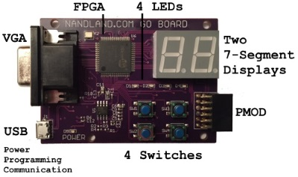
The Go Board by Russell Merrick

Slide 10
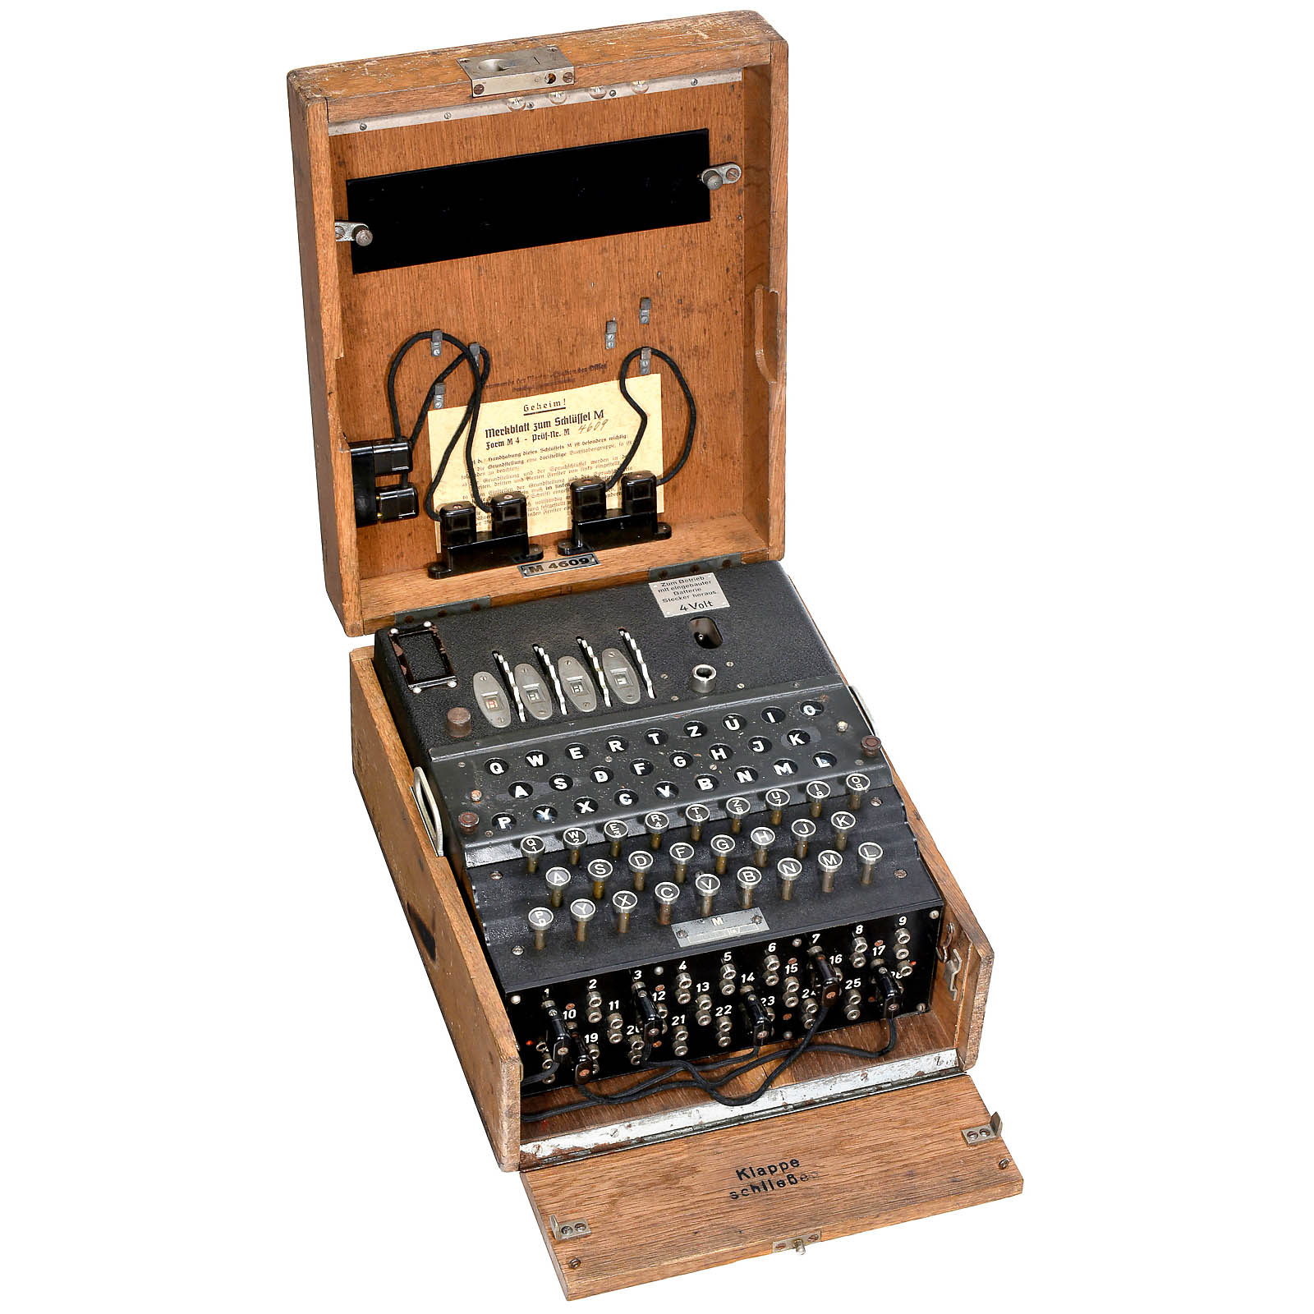
Enigma Machine

Slide 11
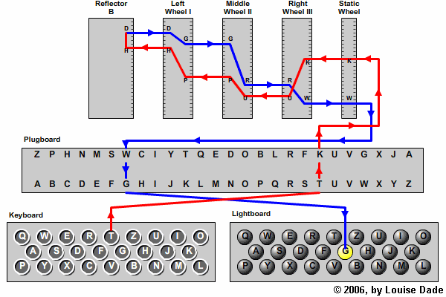
How Enigma works ?
http://enigma.louisedade.co.uk/ Enigma Emulator by Louise Dade

Slide 12
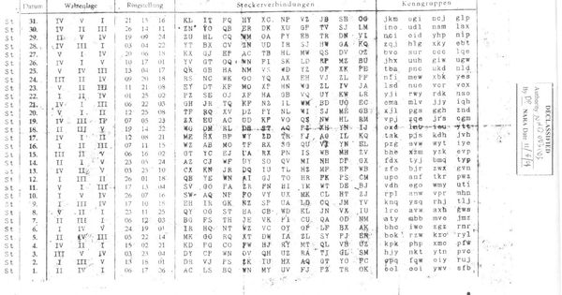
Enigma settings

Slide 13
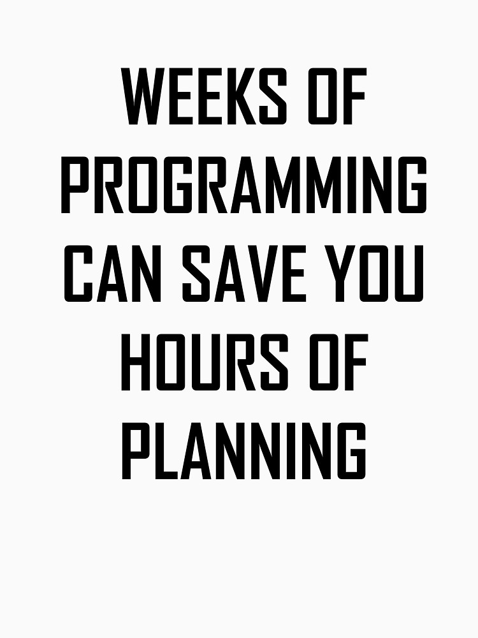
Planning

Slide 14
Architecture
LED
USB
uart
IN
uart_rx
Enigma
State machine
uart_tx
USB
uart OUT
hex_to_7seg
7seg
HI
7seg
LO
hex_to_7seg
CLK

Slide 15
Encode section
ASCII
to
code
code
to
ASCII
Plugboard
Rotor 3
encode
Rotor 2
encode
Rotor 1
encode
Reflector
encode
Rotor 1
encode
reverse
Rotor 2
encode
reverse
Rotor 3
encode
reverse
Plugboard
Rotor control
rotate

Slide 16
State machine
Reset
and Rotate
Idle
Check Key
Encode and
Rotate

Slide 17
Verilog introduction
module decodeASCII(input [4:0] code, output [7:0] ascii); assign ascii = 8'h41 + code; endmodule module encodeASCII(ascii, code, valid); input [7:0] ascii; output [4:0] code; output valid; assign valid = ((ascii < 8'h41 || ascii > 8'h5A) && (ascii < 8'h61 || ascii > 8'h7A)) ? 0 : 1; assign code = (ascii > 8'h5A) ? ascii - 8'h61 : ascii - 8'h41; endmodule
Module – Each building block is a module
Inputs/outputs
Combinational logic

Slide 18
Complex combinational logic
module reflectorEncode (code, val, reflector_type); input [4:0] code; output reg [4:0] val; input reflector_type; always @* begin if (reflector_type == 1'b0) begin // Reflector B case (code) 0 : val = "Y" - 8'h41; 1 : val = "R" - 8'h41; 2 : val = "U" - 8'h41; …. 24: val = "A" - 8'h41; 25: val = "T" - 8'h41; endcase end else begin // Reflector C case (code) 0 : val = "F" - 8'h41; 1 : val = "V" - 8'h41; …. 24: val = "H" - 8'h41; 25: val = "L" - 8'h41; endcase end end endmodule
'Y','R','U','H','Q','S','L','D','P','X','N','G','O','K','M','I','E','B','F','Z','C','W','V','J','A','T' // M3 B 'F','V','P','J','I','A','O','Y','E','D','R','Z','X','W','G','C','T','K','U','Q','S','B','N','M','H','L' // M3 C

Slide 19
Memory
module rotorEncode #(parameter REVERSE = 0) (code, rotor_type, val);
input [4:0] code;
output reg [4:0] val;
input [2:0] rotor_type;
parameter MEM_INIT_FILE = "rotors.mem";
reg [4:0] rotor_data[0:415];
initial
if (MEM_INIT_FILE != "")
$readmemh(MEM_INIT_FILE, rotor_data);
always @*
val = rotor_data[((REVERSE) ? 208 : 0) + rotor_type*26 + code];
endmodule
rotors.mem content 04 0a 0c 05 0b 06 03 10 15 19 0d 13 0e 16 18 07 17 14 12 0f 00 08
'E','K','M','F','L','G','D','Q','V','Z','N','T','O','W','Y','H','X','U','S','P','A','I','B','R','C','J' // Rotor I 'A','J','D','K','S','I','R','U','X','B','L','H','W','T','M','C','Q','G','Z','N','P','Y','F','V','O','E' // Rotor II 'B','D','F','H','J','L','C','P','R','T','X','V','Z','N','Y','E','I','W','G','A','K','M','U','S','Q','O' // Rotor III 'E','S','O','V','P','Z','J','A','Y','Q','U','I','R','H','X','L','N','F','T','G','K','D','C','M','W','B' // Rotor IV 'V','Z','B','R','G','I','T','Y','U','P','S','D','N','H','L','X','A','W','M','J','Q','O','F','E','C','K' // Rotor V 'J','P','G','V','O','U','M','F','Y','Q','B','E','N','H','Z','R','D','K','A','S','X','L','I','C','T','W' // Rotor VI 'N','Z','J','H','G','R','C','X','M','Y','S','W','B','O','U','F','A','I','V','L','P','E','K','Q','D','T' // Rotor VII 'F','K','Q','H','T','L','X','O','C','B','J','S','P','D','Z','R','A','M','E','W','N','I','U','Y','G','V' // Rotor VIII

Slide 20
Using registers, and clocked changes
module hex_to_7seg ( input i_Clk, input [3:0] i_Value, output o_Segment_A, output o_Segment_B, output o_Segment_C, output o_Segment_D, output o_Segment_E, output o_Segment_F, output o_Segment_G ); reg [6:0] out = 7'b0000000; always @(posedge i_Clk) begin case (i_Value) 4'b0000 : out <= 7'b0000001; 4'b0001 : out <= 7'b1001111; ….. endcase end assign o_Segment_A = out[6]; assign o_Segment_B = out[5]; assign o_Segment_C = out[4]; assign o_Segment_D = out[3]; assign o_Segment_E = out[2]; assign o_Segment_F = out[1]; assign o_Segment_G = out[0]; endmodule

Slide 21
Sequential logic and instantiation
module rotor ( input clock, output reg [4:0] rotor1, output reg [4:0] rotor2, output reg [4:0] rotor3, input reset, input rotate, input [2:0] rotor_type_1, input [2:0] rotor_type_2, input [2:0] rotor_type_3, input [4:0] rotor_start_1, input [4:0] rotor_start_2, input [4:0] rotor_start_3 ); wire knock1; wire knock2; reg prev_rotate = 1'b0; reg prev_knock1 = 1'b0; reg prev_knock2 = 1'b0; checkKnockpoints checker3(.position(rotor3), .knockpoint(knock1), .rotor_type(rotor_type_3)); checkKnockpoints checker2(.position(rotor2), .knockpoint(knock2), .rotor_type(rotor_type_2)); always @(posedge clock) begin if (reset) begin rotor1 <= rotor_start_1; rotor2 <= rotor_start_2; rotor3 <= rotor_start_3; prev_rotate <= 0; prev_knock1 <= 0; prev_knock2 <= 0; end else begin if ((prev_rotate==0) && (rotate==1)) rotor3 <= (rotor3 == 25) ? 0 : rotor3 + 1; if ((prev_knock1==0) && (knock1==1)) rotor2 <= (rotor2 == 25) ? 0 : rotor2 + 1; if ((prev_knock2==0) && (knock2==1)) rotor1 <= (rotor1 == 25) ? 0 : rotor1 + 1; prev_rotate <= rotate; prev_knock1 <= knock1; prev_knock2 <= knock2; end end endmodule

Slide 22
Test bench
module testrotor(); reg [2:0] rotor_type_3 = 3'b010; reg [2:0] rotor_type_2 = 3'b001; reg [2:0] rotor_type_1 = 3'b000; reg [4:0] rotor_start_3 = 5'b00000; reg [4:0] rotor_start_2 = 5'b00000; reg [4:0] rotor_start_1 = 5'b00000; reg [4:0] ring_position_3 = 5'b00000; reg [4:0] ring_position_2 = 5'b00000; reg [4:0] ring_position_1 = 5'b00000; reg reflector_type = 1'b0; reg i_clock = 0; reg reset; reg rotate = 0; wire [4:0] rotor1; wire [4:0] rotor2;wire [4:0] rotor3; integer i; rotor rotorcontrol(.clock(i_clock),.rotor1(rotor1),.rotor2(rotor2),.rotor3(rotor3), .reset(reset),.rotate(rotate), .rotor_type_1(rotor_type_1),.rotor_type_2(rotor_type_2),.rotor_type_3(rotor_type_3), .rotor_start_1(rotor_start_1),.rotor_start_2(rotor_start_2),.rotor_start_3(rotor_start_3)); always #(5) i_clock <= !i_clock; initial begin $dumpfile("testrotor.vcd"); $dumpvars(0,testrotor); #5 reset = 1; #10 reset = 0; for (i = 0; i < 30; i = i + 1) begin #10 rotate = 1; #10 rotate = 0; #10 $display("Rotors [%c] [%c] [%c]",rotor1+65,rotor2+65,rotor3+65); end $finish; end endmodule

Slide 23
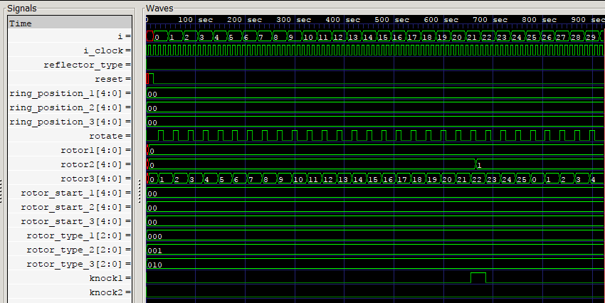
Running tests
iverilog testrotor.v rotor.v checkKnockpoints.v
vvp a.out
VCD info: dumpfile testrotor.vcd opened for output.
Rotors [A] [A] [B]
Rotors [A] [A] [C]
Rotors [A] [A] [D]
Rotors [A] [A] [E]
Rotors [A] [A] [F]
Rotors [A] [A] [G]
Rotors [A] [A] [H]
Rotors [A] [A] [I]
Rotors [A] [A] [J]
Rotors [A] [A] [K]
Rotors [A] [A] [L]
Rotors [A] [A] [M]
Rotors [A] [A] [N]
Rotors [A] [A] [O]
Rotors [A] [A] [P]
Rotors [A] [A] [Q]
Rotors [A] [A] [R]
Rotors [A] [A] [S]
Rotors [A] [A] [T]
Rotors [A] [A] [U]
Rotors [A] [A] [V]
Rotors [A] [B] [W]
Rotors [A] [B] [X]
Rotors [A] [B] [Y]
Rotors [A] [B] [Z]
Rotors [A] [B] [A]
Rotors [A] [B] [B]
Rotors [A] [B] [C]
Rotors [A] [B] [D]
Rotors [A] [B] [E]

Slide 24
State machine
always @(posedge i_clock) begin case (state) STATE_RESET : // Reset and rotate begin reset <= 1'b0; state <= STATE_IDLE; o_ready <= 1'b0; o_outputData <= 8'b00000000; rotate <= 1'b1; end STATE_IDLE : // Idle –wait for key begin o_ready <= 1'b0; state <= i_ready ? STATE_CHECKKEY : STATE_IDLE; end STATE_CHECKKEY : // Check key value (cut down version) begin o_ready <= 1'b0; rotate <= 1'b0; state <= (valid) ? STATE_ENCODE : STATE_IDLE; end STATE_ENCODE : // Encode and rotate for next begin rotate <= 1’b1; o_ready <= 1'b1; o_outputData <= final_ascii; state <= STATE_IDLE; end endcase End

Slide 25
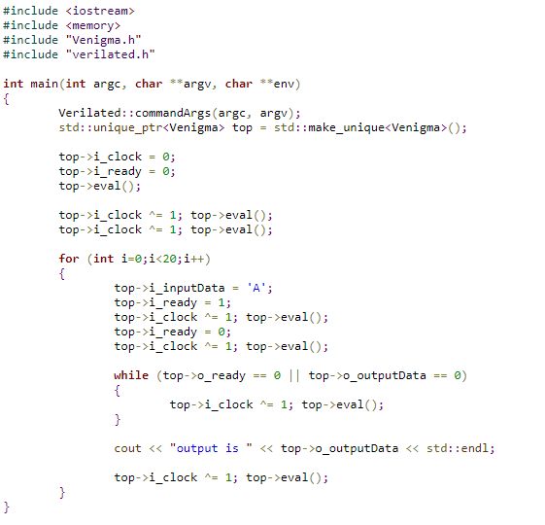
Testing using C++ (Verilator)

Slide 26
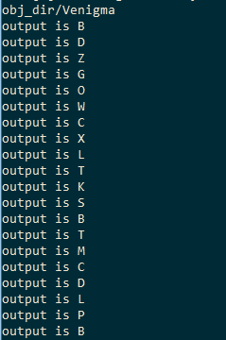
Running verilator and building test
verilator -Wall --cc enigma.vlt state_machine.v encode.v rotor.v encodeASCII.v decodeASCII.v rotorEncode.v reflectorEncode.v plugboardEncode.v checkKnockpoints.v --exe main.cpp
make -C obj_dir -j -f Venigma.mk Venigma
Output or test running :

Slide 27
Constraints file
### Main FPGA Clock set_io i_Clk 15 ### LED Pins: set_io o_LED_1 56 set_io o_LED_2 57 set_io o_LED_3 59 set_io o_LED_4 60 ### 7 Segment Outputs set_io o_Segment1_A 3 set_io o_Segment1_B 4 set_io o_Segment1_C 93 set_io o_Segment1_D 91 set_io o_Segment1_E 90 set_io o_Segment1_F 1 set_io o_Segment1_G 2 set_io o_Segment2_A 100 set_io o_Segment2_B 99 set_io o_Segment2_C 97 set_io o_Segment2_D 95 set_io o_Segment2_E 94 set_io o_Segment2_F 8 set_io o_Segment2_G 96 ## UART Outputs set_io i_UART_RX 73 set_io o_UART_TX 74

Slide 28
Compile for Go Board
yosys -q -p "synth_ice40 -abc2 -nocarry -top enigma_top -blif enigma.blif" enigma_top.v state_machine.v encode.v rotor.v encodeASCII.v decodeASCII.v rotorEncode.v reflectorEncode.v plugboardEncode.v checkKnockpoints.v hex_to_7seg.v uart_tx.v uart_rx.v
arachne-pnr -d 1k -P vq100 -p Go_Board_Constraints.pcf enigma.blif -o enigma.txt
icepack enigma.txt enigma.bin
icetime -d hx1k -P vq100 enigma.txt
iceprog enigma.bin

Slide 29
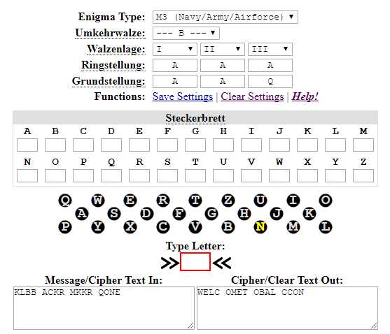
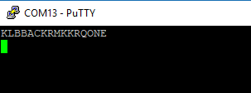

Running example
Doing check with same message to
see if we did a good job
Typing on terminal original text
and we get encoded text back
Pressing ESC and resetting terminal
Typing encoded text now, and we
get decoded text now

Slide 30
Live demo

Slide 31
More info
Full source https://github.com/mmicko/enigmaFPGA
nandland channel on YouTube with tutorials
https://www.nandland.com/ to order Go Board
( code ENIGMA for 10% off till end of September)
http://www.fpga4student.com/ for more nice tutorials

